Slide 1

Self Balancing Tree
Presented By:
Samarth Agarwal
Mohit Bharti
Mohit Soni

Slide 2
Content
AVL Trees
Red & Black Tree
Real Life Implementations

Slide 3
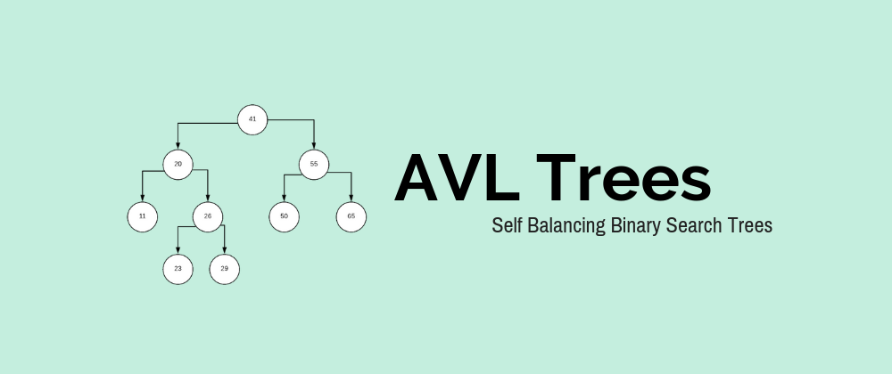

Slide 4
Why AVL TREES ??
Most of the BST operations (e.g., search, max, min, insert, delete.. etc) take O(h) time where h is the height of the BST. The cost of these operations may become O(n) for a skewed Binary tree. If we make sure that height of the tree remains O(Logn) after every insertion and deletion, then we can guarantee an upper bound of O(Logn) for all these operations. The height of an AVL tree is always O(Logn) where n is the number of nodes in the tree .

Slide 5
Balanced Binary Search Trees
If the height of a binary tree is always O(log n), we can guarantee O(log n) performance for each search tree operation
•Trees with a worst-case height of O(log n) are called balanced trees
•An example of a balanced tree is AVL (Adelson-Velsky and Landis) tree

Slide 6
Definition
Binary tree.
•If T is a nonempty binary tree with T_{L} and T_{R} as its left and right subtrees, then T is an AVL tree iff
1.T_{L} and T_{R} are AVL trees, and
2.|h_{L} – h_{R}| £ 1 where h_{L} and h_{R} are the heights of T_{L} and T_{R}, respectively

Slide 7
Properties of AVL Tree
1.The height of an AVL tree with n nodes is O(log n)
2.For every value of n, n >= 0, there exists an AVL tree
3.An n-node AVL search tree can be searched in O(height) = O(log n) time
4.A new node can be inserted into an n-node AVL search tree so that the result is an n+1 node AVL tree and insertion can be done in O(log n) time
5.A node can be deleted from an n-node AVL search tree, n>0, so that the result is an n-1 node AVL tree and deletion can be done in O(log n) time

Slide 8
Balance Factor
•AVL trees are normally represented using the linked representation
•To facilitate insertion and deletion, a balance factor (bf) is associated with each node
•The balance factor bf(x) of a node x is defined as
height(x->leftChild) – height(x->rightChild)
•Balance factor of each node in an AVL tree must be
–1, 0, or 1

Slide 9
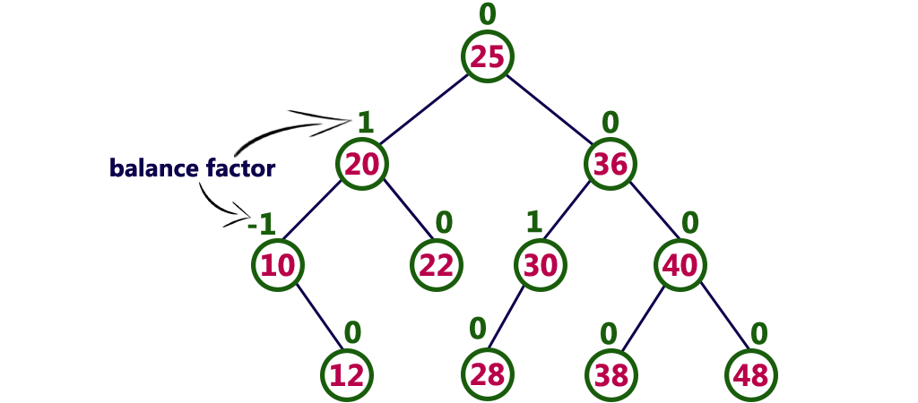
A non-empty BST is an AVL search tree iff, the balance factors of every node in the tree is either 0, 1 or -1.

Slide 10
Insertion in AVL Tree
Insertion of a key into an AVL tree proceeds in the same way as that of a BST.
However, if while inserting a key, the BF of any node falls out of the permissible limit (i.e. 0, 1 or -1), then we need to apply rotations to make the tree height-balanced.

Slide 11
What are the different types of rotation?
•LL: The inserted node X is in the left sub-tree of the left sub-tree of the node A.
•RR: The inserted node X is in the right sub-tree of the right sub-tree of the node A.
•LR: The inserted node X is in the right sub-tree of the left sub-tree of the node A.
•RL: The inserted node X is in the left sub-tree of the right sub-tree of the node A.

Slide 12
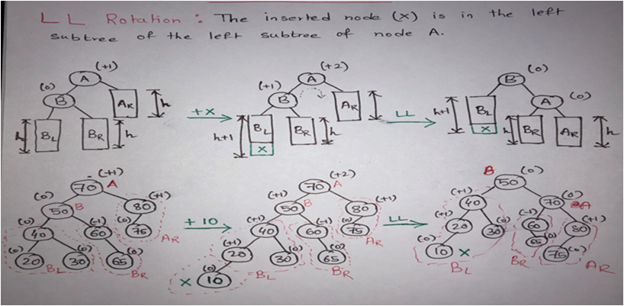
LL Rotation

Slide 13
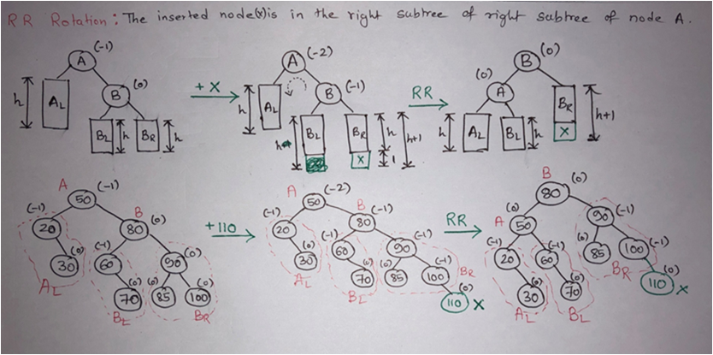
RR Rotation

Slide 14
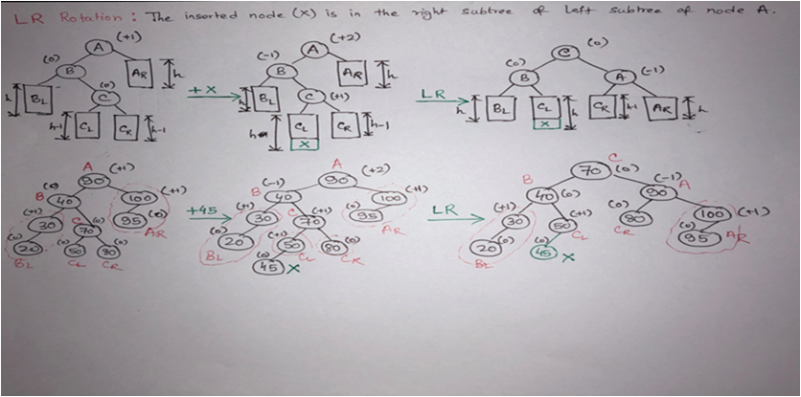
LR Rotation

Slide 15
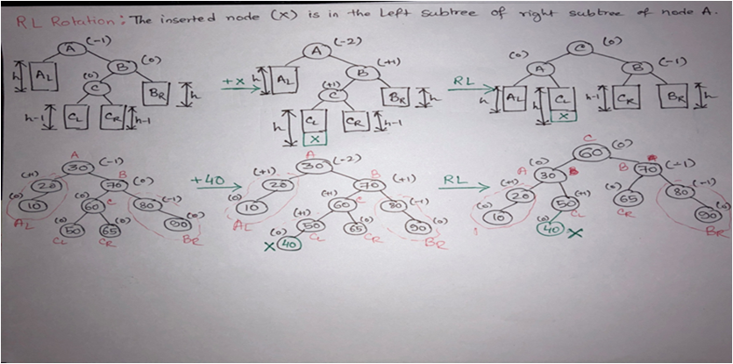
RL Rotation

Slide 16
Analysis
Single rotation preserves the original height:
–The new height of the entire subtree is exactly the same as the height of the original subtree before the insertion.
•Therefore it is enough to do rotation only at the first node, where imbalance exists, on the path from inserted node to root.
•Thus the rotation takes O(1) time.
•Hence insertion is O(logN)

Slide 17
Deletion of a Node
•Deletion of a node x from an AVL tree requires the same basic ideas, including single and double rotations, that are used for insertion.
•With each node of the AVL tree is associated a balance factor that is left high, equal or right high according, respectively, as the left subtree has height greater than, equal to, or less than that of the right subtree.

Slide 18
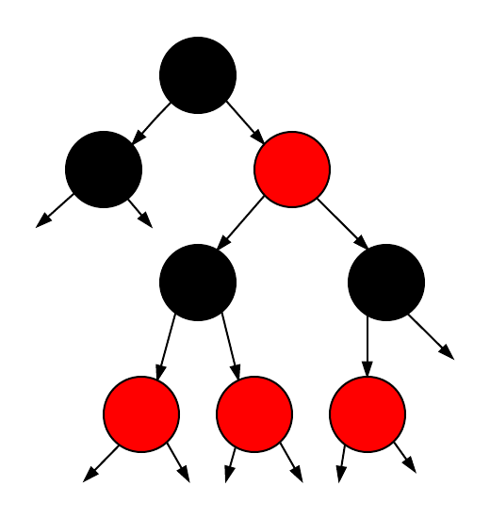
Red-Black Tree

Slide 19
Red-Black Tree
Red-Black Tree is a self-balancing Binary Search Tree (BST) where every node follows following rules.
1) Every node has a color either red or black.
2) Root of tree is always black.
3) There are no two adjacent red nodes (A red node cannot have a red parent or red child).
4) Every path from a node (including root) to any of its descendant NULL node has the same number of black nodes.

Slide 20
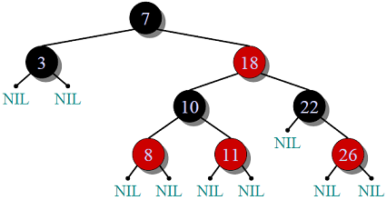
Why Red-Black Trees?
Most of the BST operations (e.g., search, max, min, insert, delete.. etc) take O(h) time where h is the height of the BST. The cost of these operations may become O(n) for a skewed Binary tree. If we make sure that height of the tree remains O(Logn) after every insertion and deletion, then we can guarantee an upper bound of O(Logn) for all these operations. The height of a Red-Black tree is always O(Logn) where n is the number of nodes in the tree.

Slide 21
Comparison with AVL Tree
The AVL trees are more balanced compared to Red-Black Trees, but they may cause more rotations during insertion and deletion. So if your application involves many frequent insertions and deletions, then Red Black trees should be preferred. And if the insertions and deletions are less frequent and search is a more frequent operation, then AVL tree should be preferred over Red-Black Tree.
How does a Red-Black Tree ensure balance?
A simple example to understand balancing is, a chain of 3 nodes is not possible in the Red-Black tree. We can try any combination of colours and see all of them violate Red-Black tree property.

Slide 22
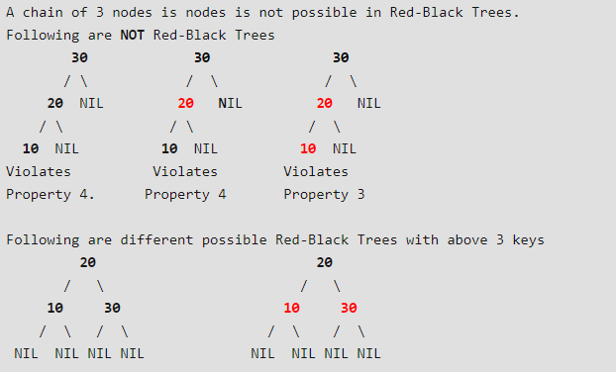

Slide 23
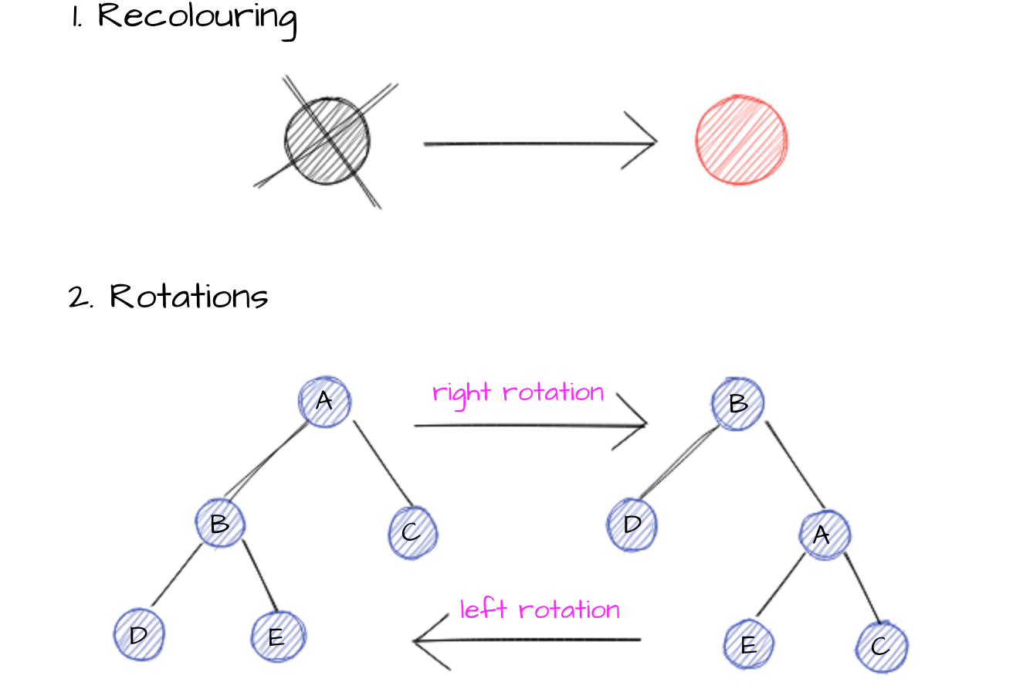
Insertion
In Red-Black Trees after inserting an element two types of actions are used to assure balancing and bring back violated properties:

Slide 24


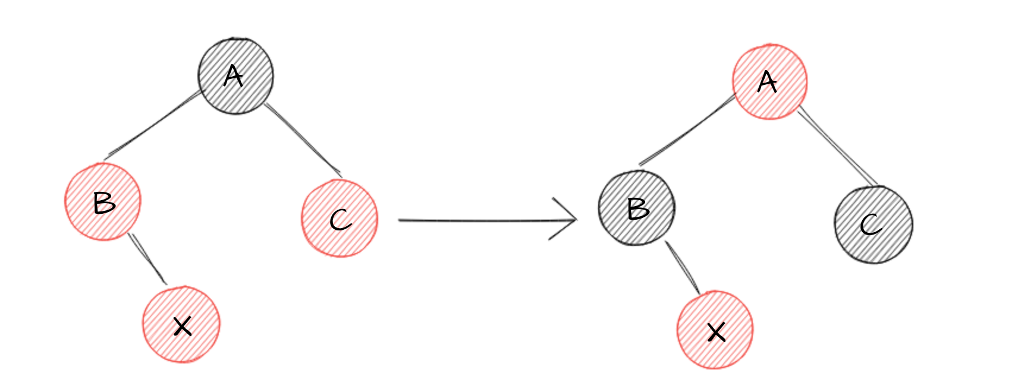
We inserted a node X, which violated Red-Black Tree properties. Time for recover. We have four possible scenarios:
Inserted element X is a root
2. X’s uncle is red

Slide 25
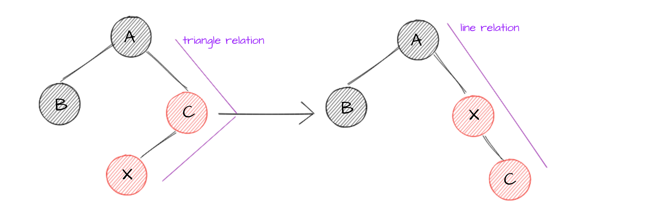
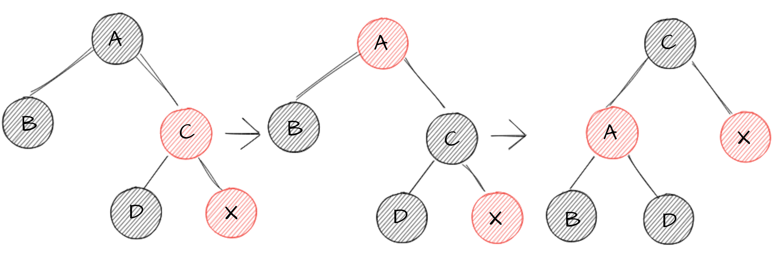
3. X’s uncle is black (triangle)
4. X’s uncle is black (line)

Slide 26
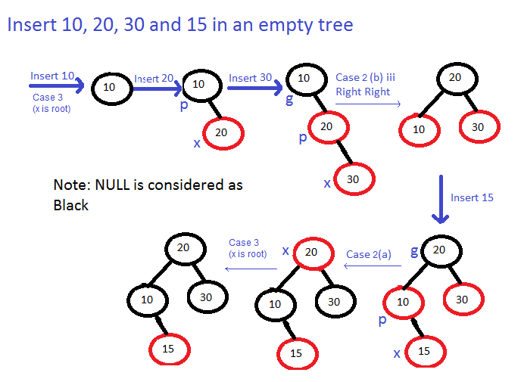

Slide 27
Real world applications of Red-Black Trees
They are used in map, multimap, multiset from C++ STL and java.util.TreeMap , java.util.TreeSet from Java. Besides they are use in K-mean clustering algorithm for reducing time complexity.
MySQL uses Red-Black Trees for indexes on tables. That makes some significant usages

Slide 28
Real Life Implementation of Tree

Slide 29
Seat Booking in IRCTC
->IRCTC uses AVL tree for seat booking.
->benefit of using Avl tree is that we can book seats efficiently and use available resources more efficiently.

Slide 30
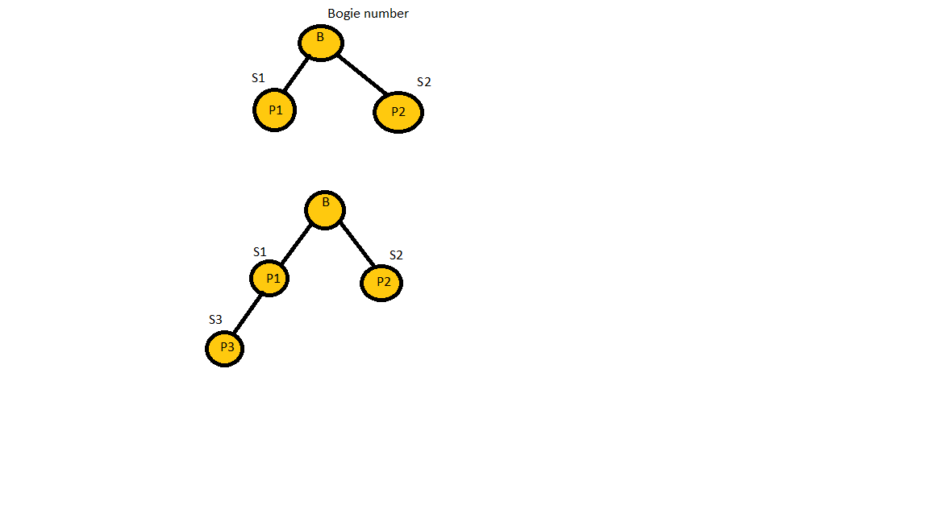

Slide 31
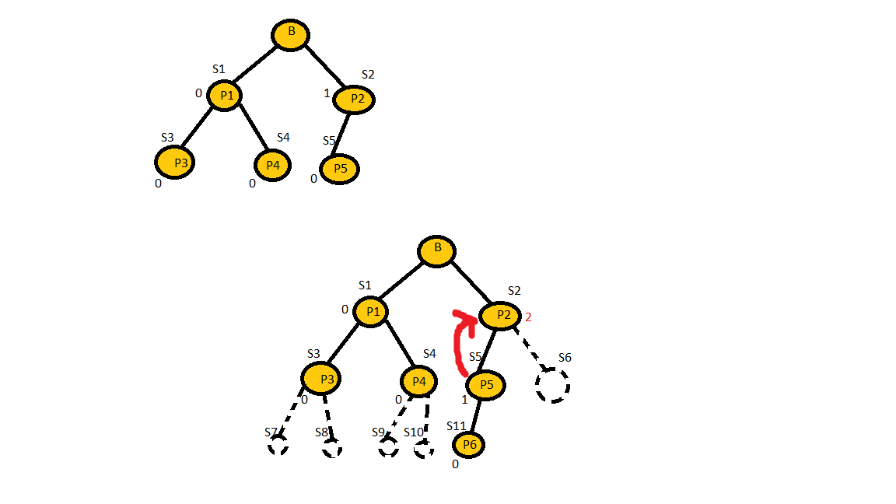

Slide 32
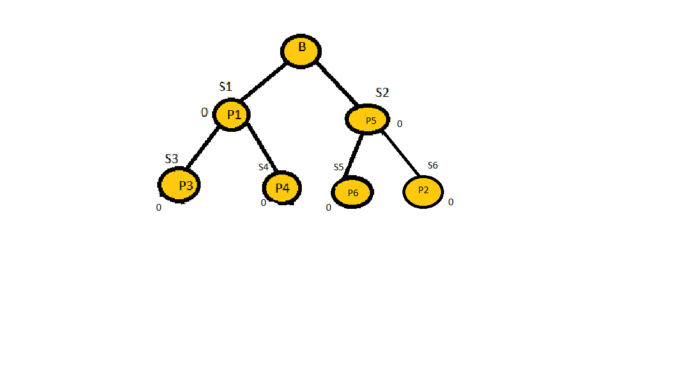

Slide 33
File Management in Operating System
-> It is example of Tree but not AVL tree.

Slide 34
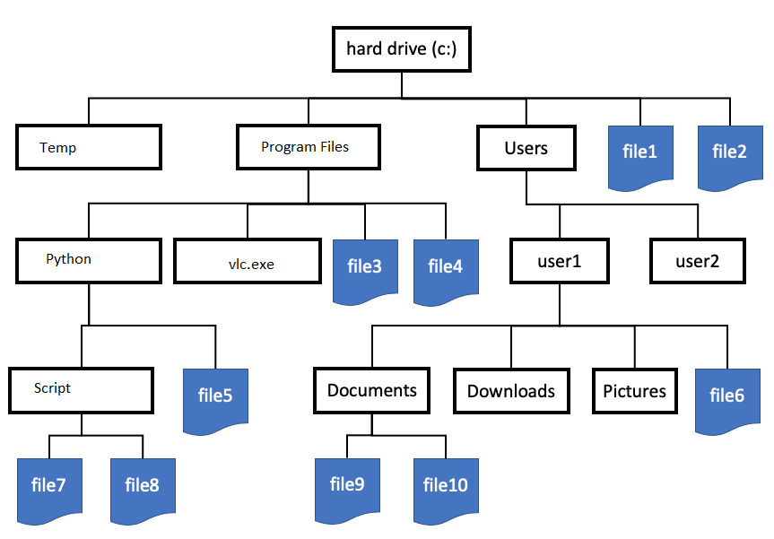

Slide 35


